Slide 1
Ch 17 : pymol Ch 21 : PDB 3D
조강익

Slide 2
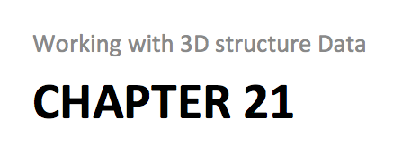
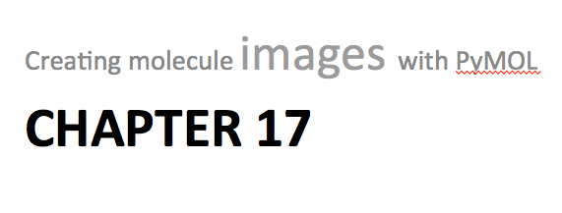
Recipe 14
Recipe 15
Recipe 16

Slide 3
Chapter 21
Working with 3D structure Data

Slide 4
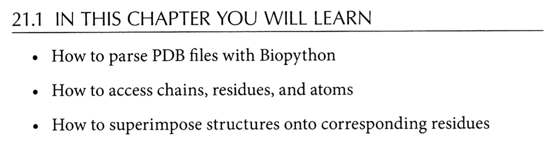

Slide 5
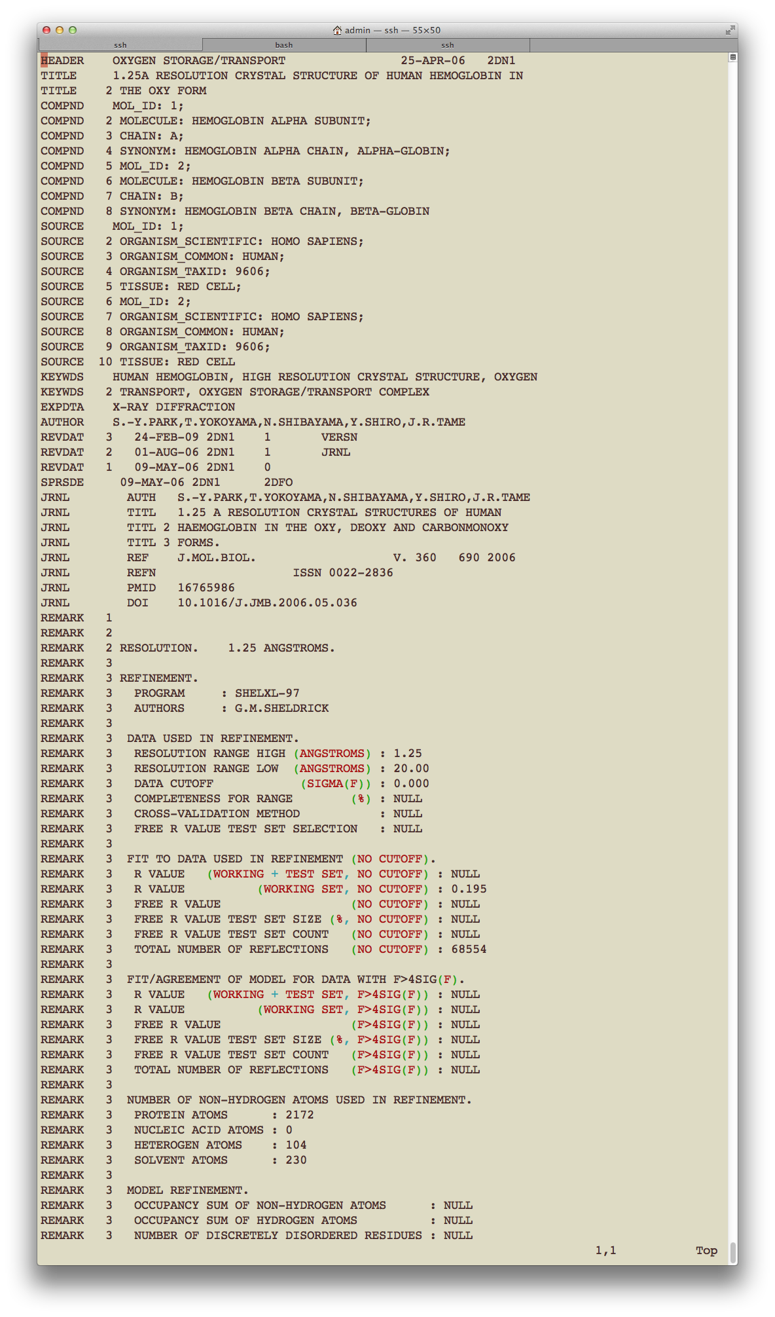

Slide 6
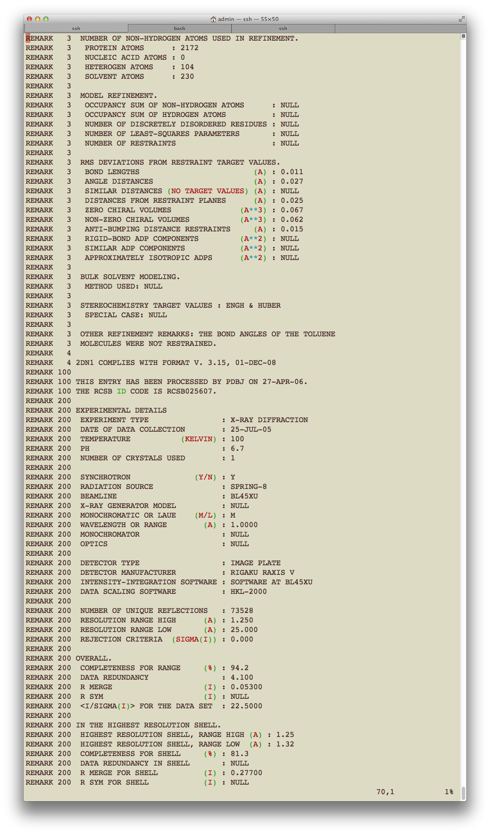

Slide 7
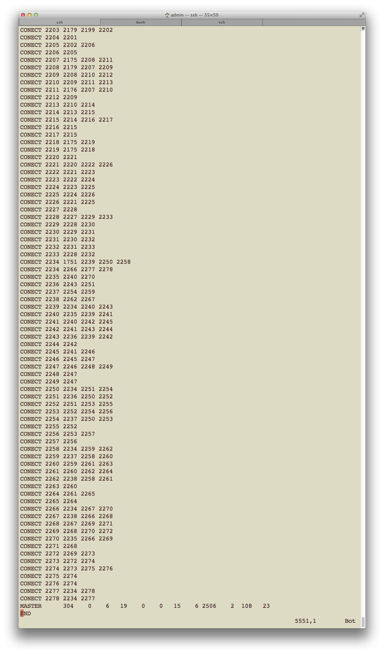

Slide 8
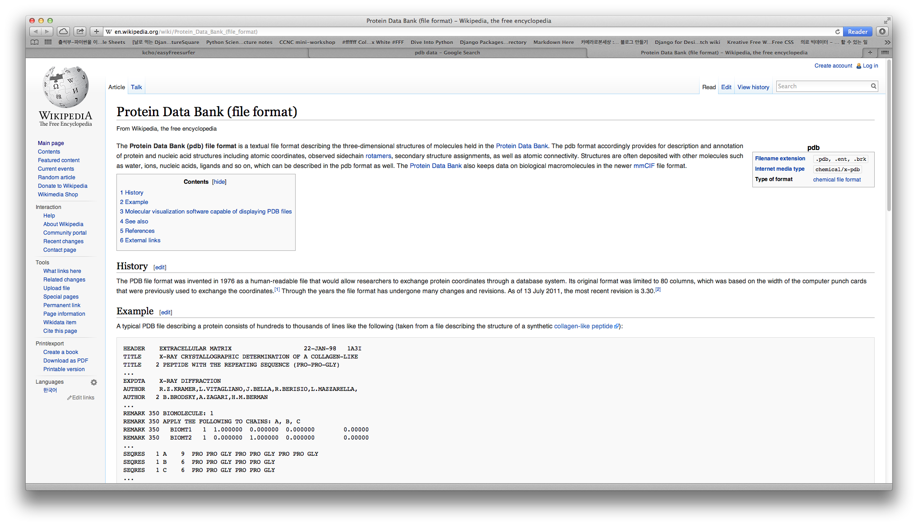
http://en.wikipedia.org/wiki/Protein_Data_Bank_(file_format)

Slide 9
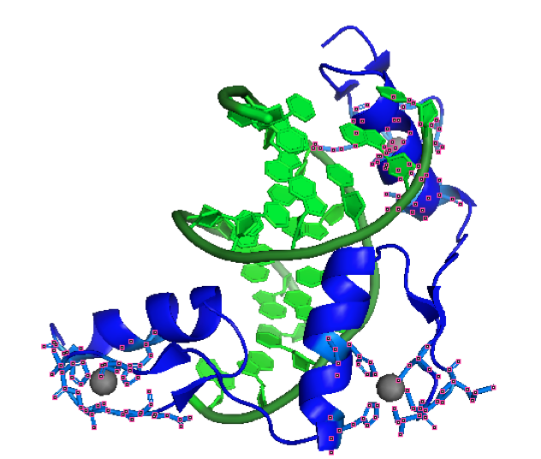
name
location

Slide 10
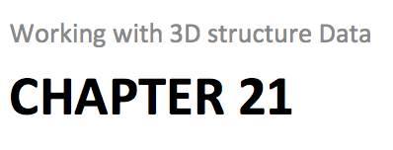
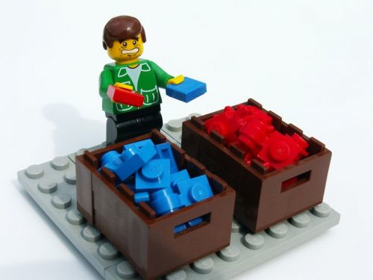
http://www.craiglotter.co.za/wp-content/uploads/2010/04/data-sorting-lego.jpg

Slide 11
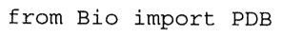

Slide 12

http://www.bloggang.com/data/a/asiaw/picture/1346398879.jpg
Structure
Model
Chain
Residue
Atom

Slide 13
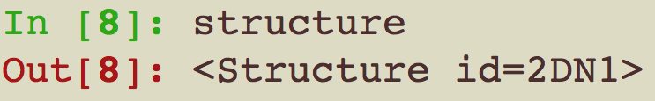

Slide 14
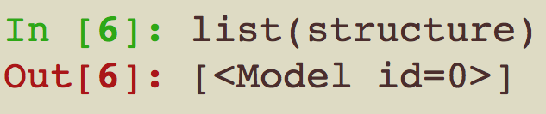
Model

Slide 15
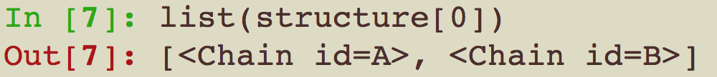

Chain

Slide 16
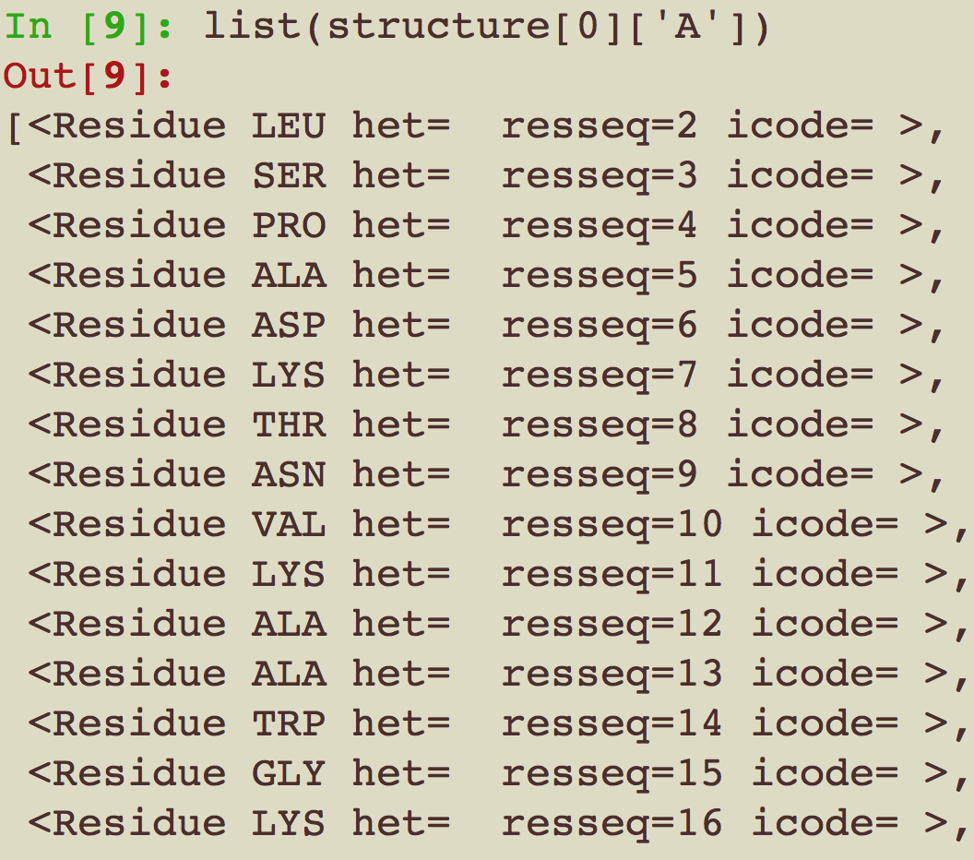
Residue

Slide 17
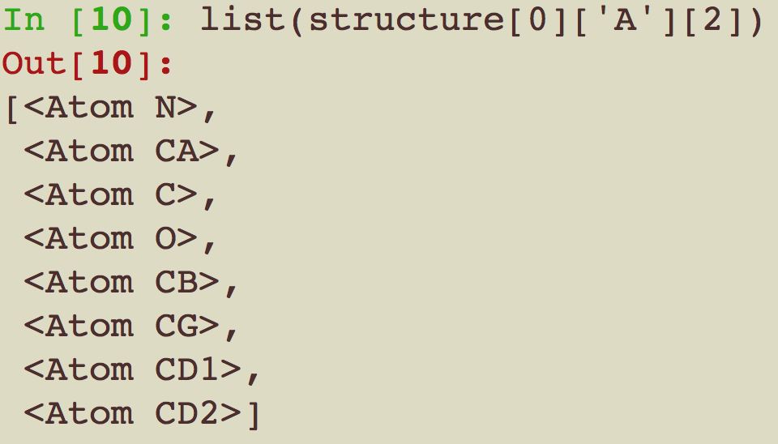
Atom

Slide 18
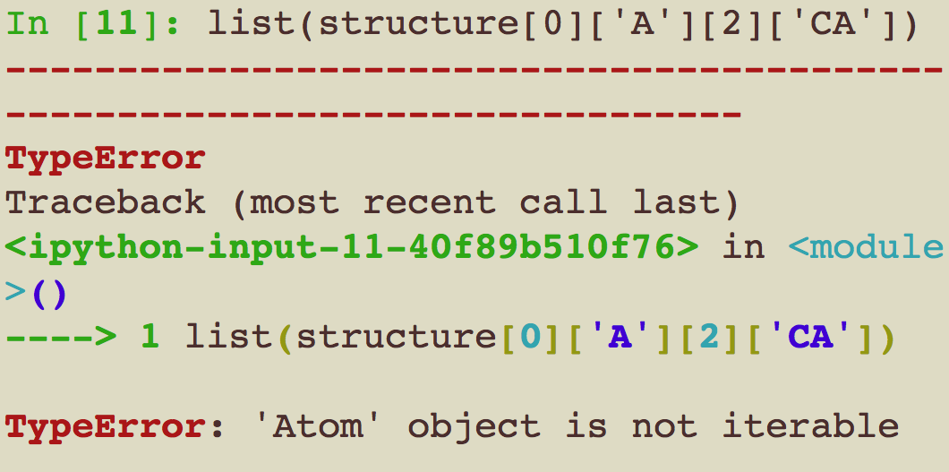

Slide 19
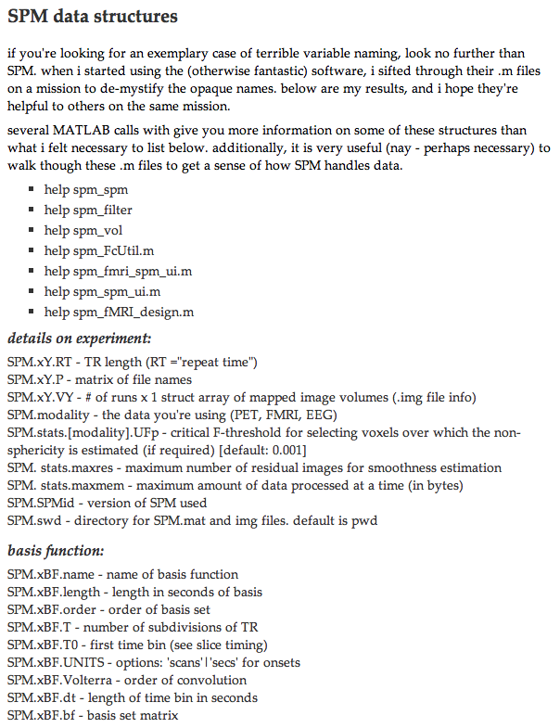
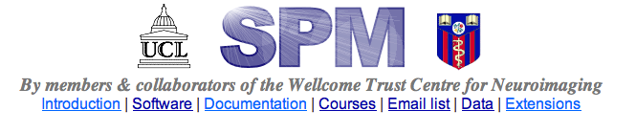
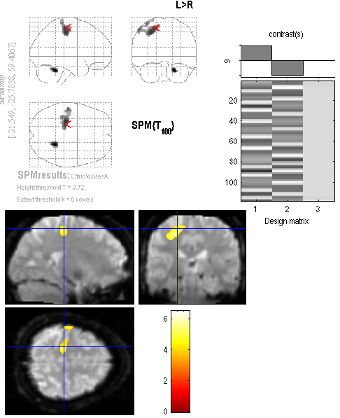
http://www.fil.ion.ucl.ac.uk/spm/
http://www.cabiatl.com/Resources/SPM/spm_results.png
http://www.its.caltech.edu/~nsulliva/spmdatastructure.htm

Slide 20
Chapter 21 Example
Working with 3D structure Data

Slide 21
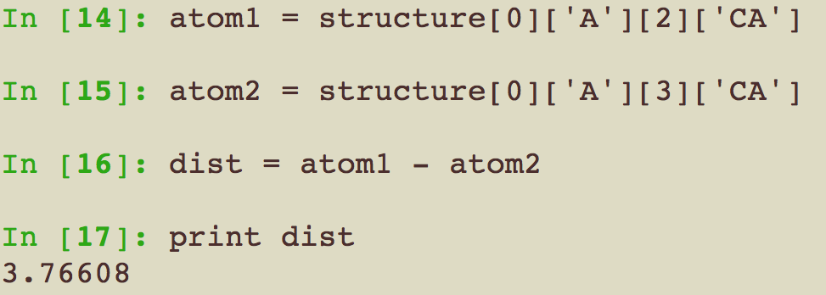
Q. Distance between two atoms

Slide 22
Q. Finding the Two Closest CA atoms In a PDB Structure
Get CA atom list
Loop for position for 1 atom
Loop for position for the other atom
Calculate distance
Compare with previous
Output the minimum distance

Slide 23
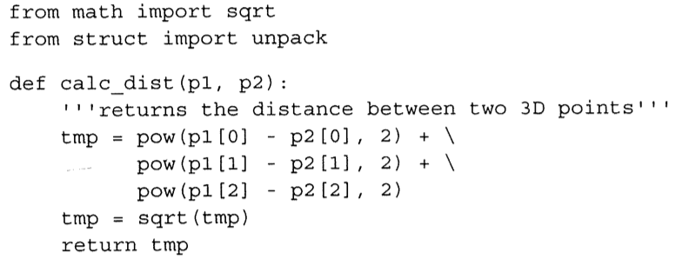

Slide 24
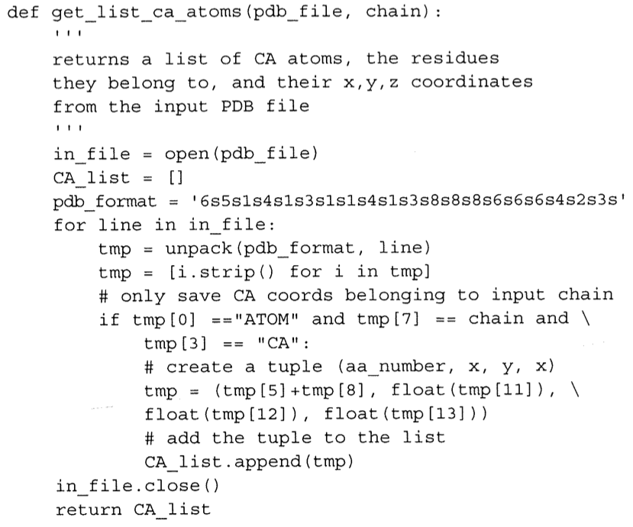

Slide 25
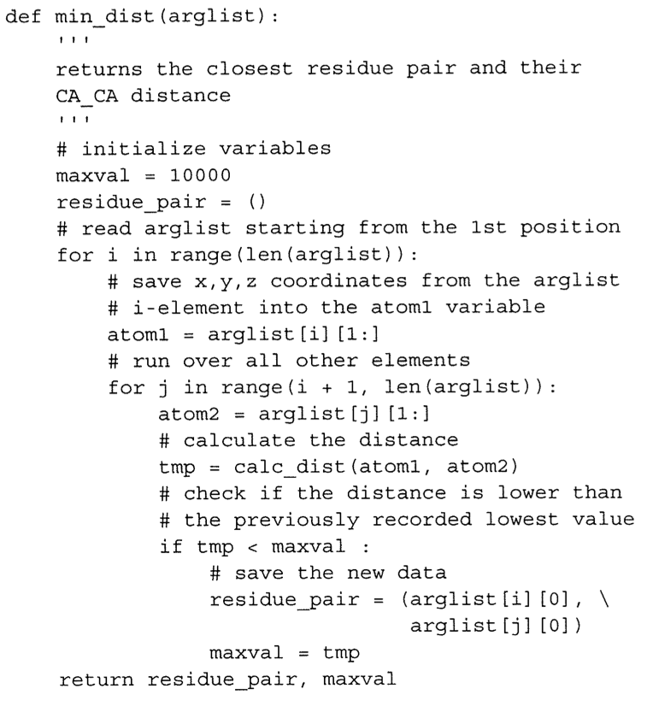

Slide 26
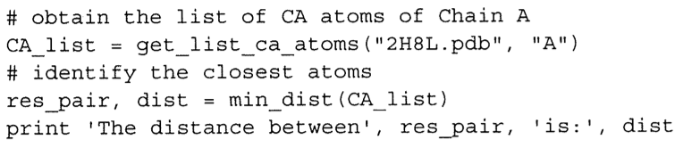

Slide 27
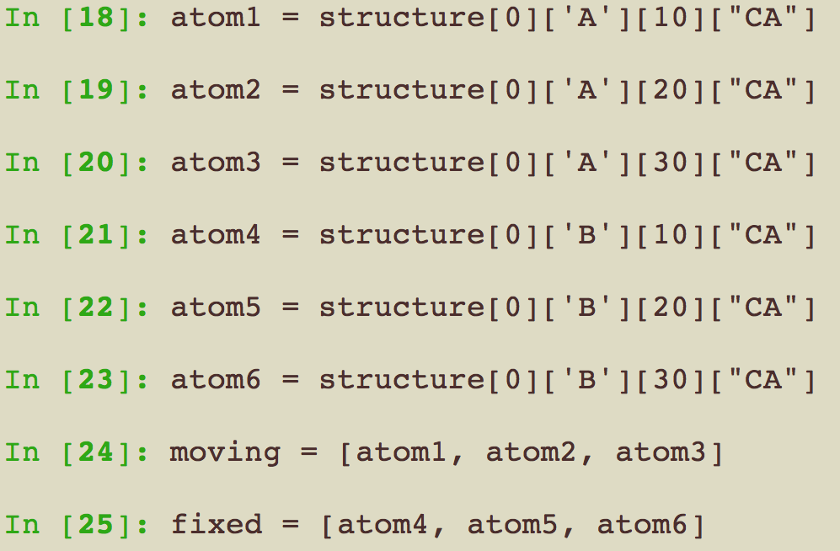
Quality of the fit between two structures

Slide 28
Quality of the fit between two structures

Slide 29
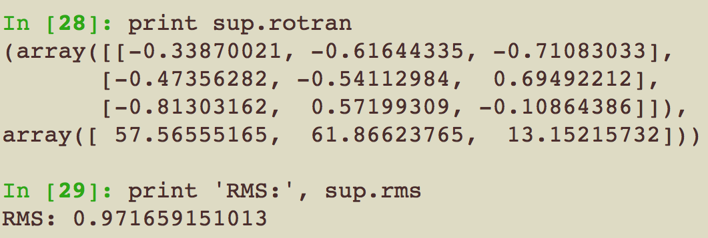
Quality of the fit between two structures

Slide 30
Model
chain_A.pdb
chain_B.pdb

Slide 31
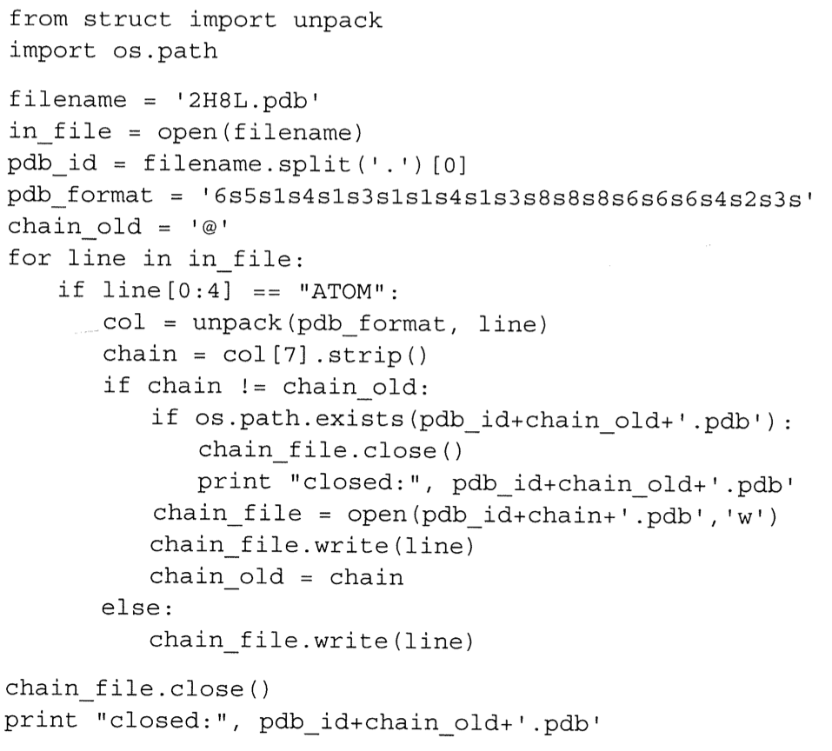

Slide 32
Summary
A lot of data
Bio.PDB
PDB.PDBParser()
PDB.Superimposer()
get_structure
rms, rotran
PDB file
Structure
Hierarchical variable

Slide 33
Chapter 17 + server
Creating molecule images with PyMOL

Slide 34
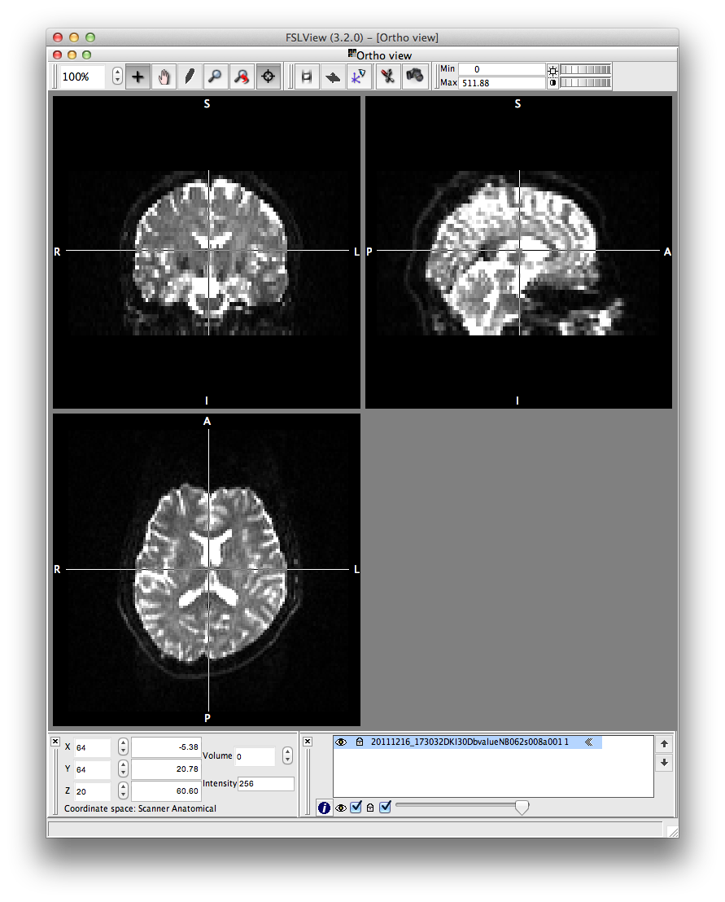
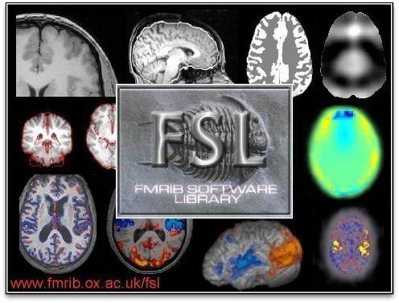
http://fsl.fmrib.ox.ac.uk

Slide 36
guest6
thssla6!
guest5
thssla5!
guest1~9
thssla1~9!

Slide 37
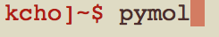

Slide 38
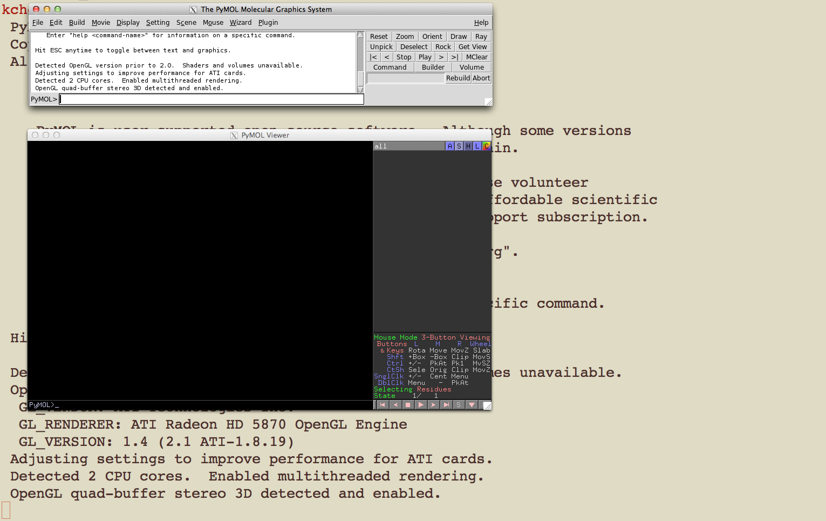

Slide 39
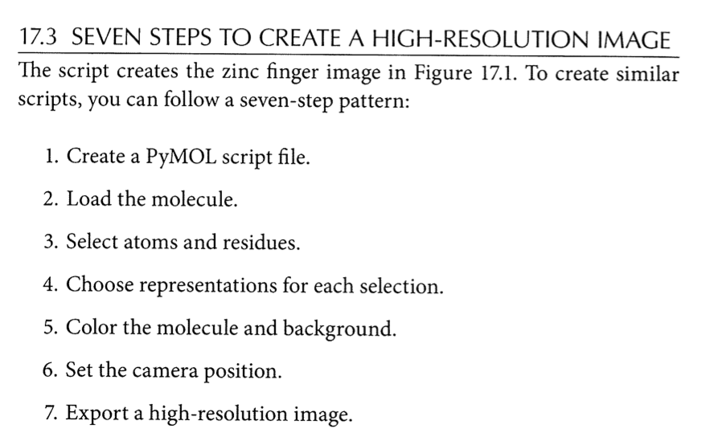

Slide 40
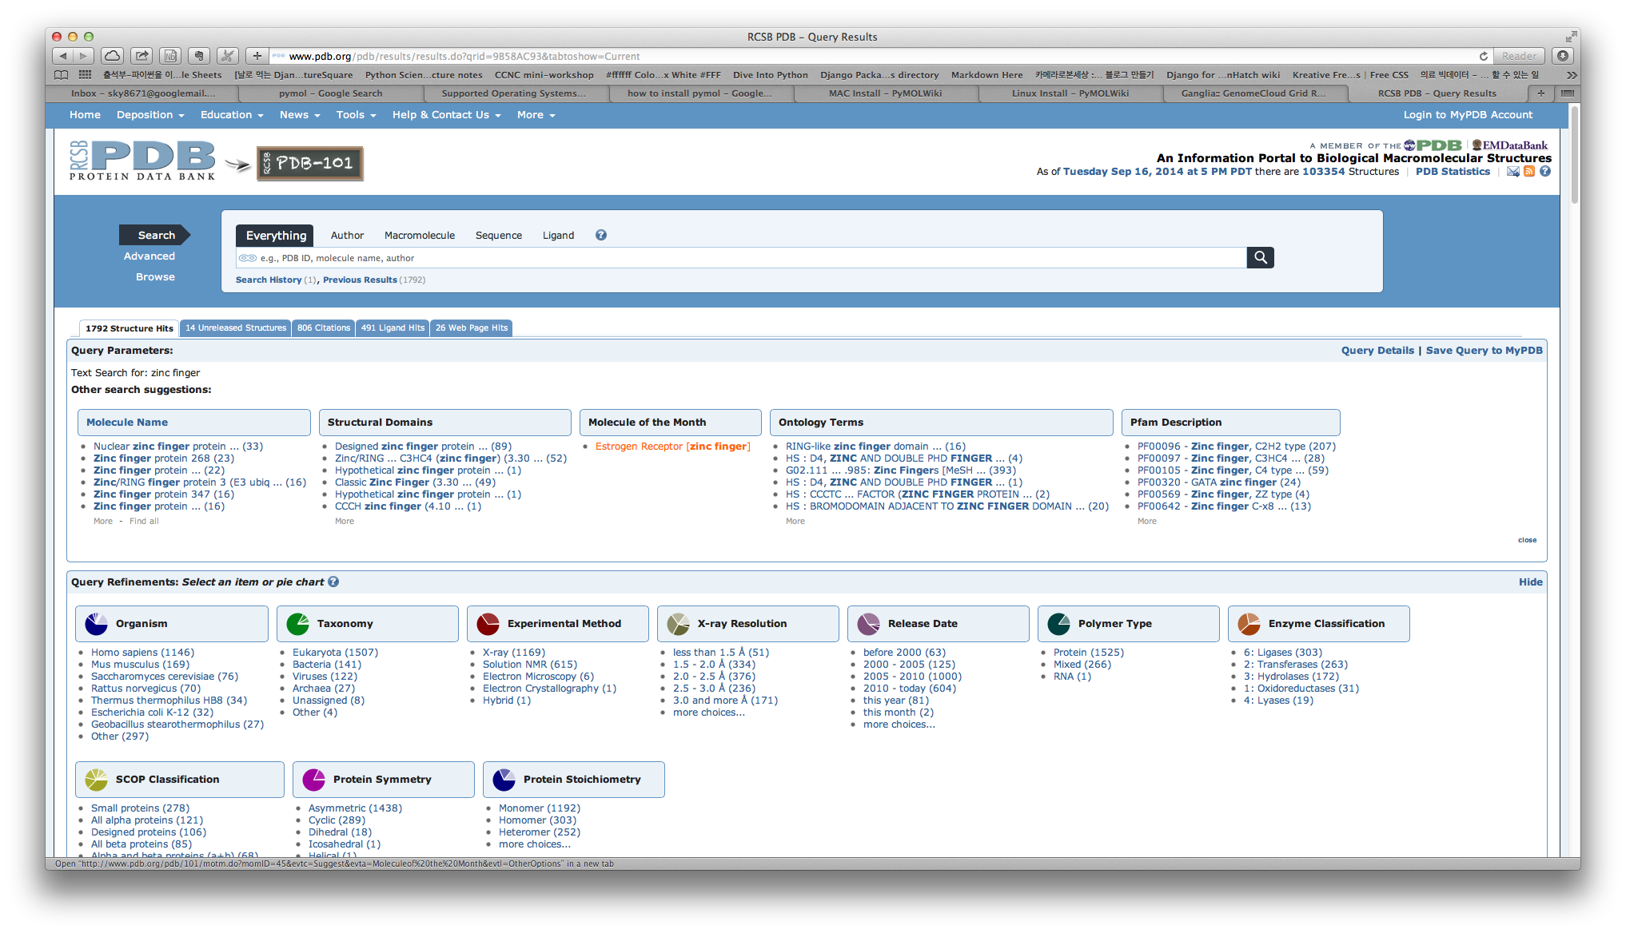

Slide 41
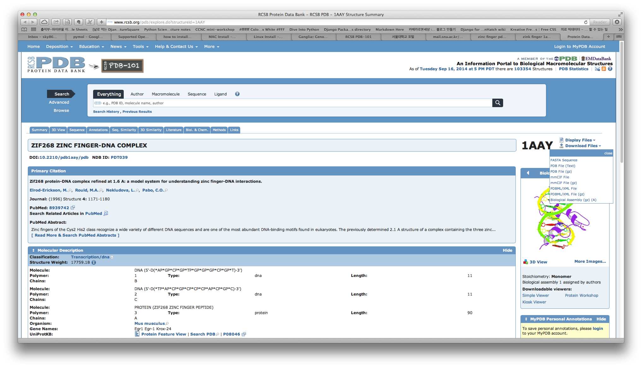

Slide 42
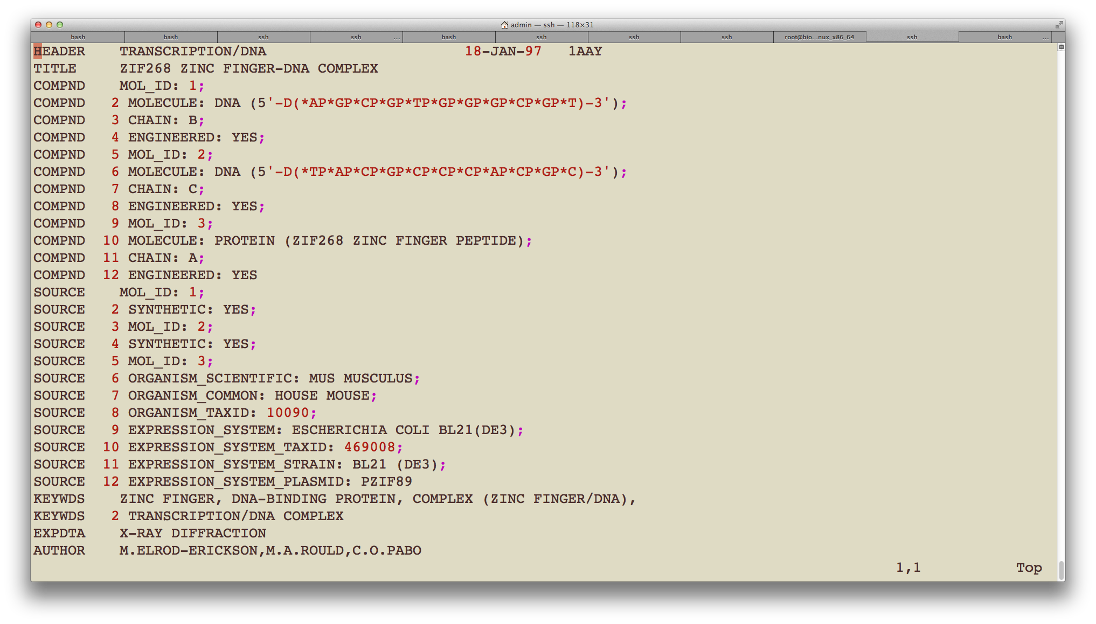

Slide 43
load 1aay.pdb, zinc_finger
hide everything
bg_color white
select zinc_finger, chain a
show cartoon, zinc_finger
color blue, zinc_finger
select dna, chain b or chain c
select dna_backbone, elem p
show cartoon, dna
set cartoon_ring_mode, 3
color green, dna
color forest, dna_backbone
select zinc, resn zn
show spheres, zinc
color gray, zinc
select atoms_pocket, zinc around 5.0 and not zinc
select pocket, byres atoms_pocket
show sticks, pocket
set valence, 1
set_view (\
0.385022461, -0.910319746, -0.151902989,\
-0.748979092, -0.212032005, -0.627752066,\
0.539247334,0.355471820,-0.763447404,\
0.000005471,0.000029832,-134.466125488,\
1.499966264,12.841400146,50.074134827,\
100.975906372,167.958770752,0.000)
ray 800,600
png zinc_finger.png

Slide 44
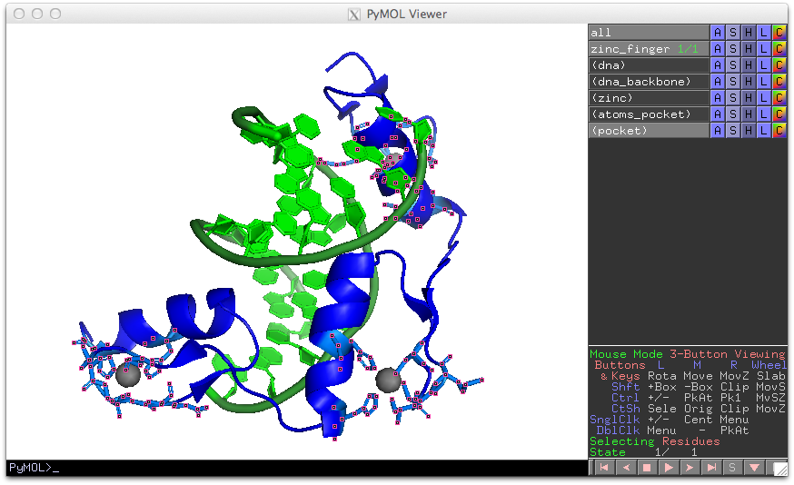

Slide 45
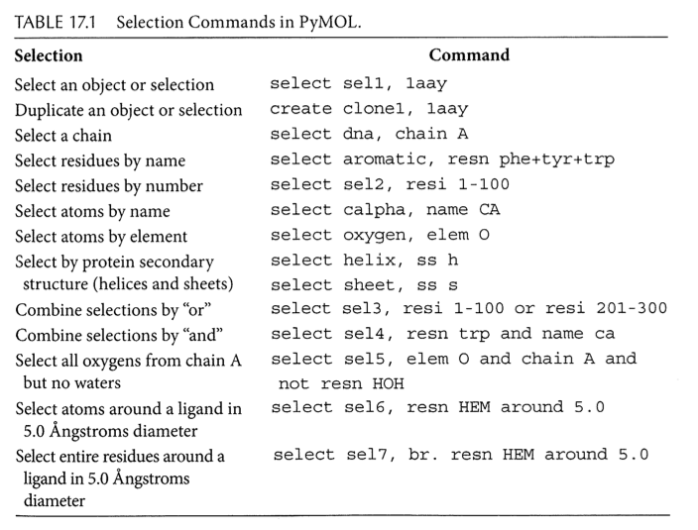

Slide 46
Thanks

Slide 47
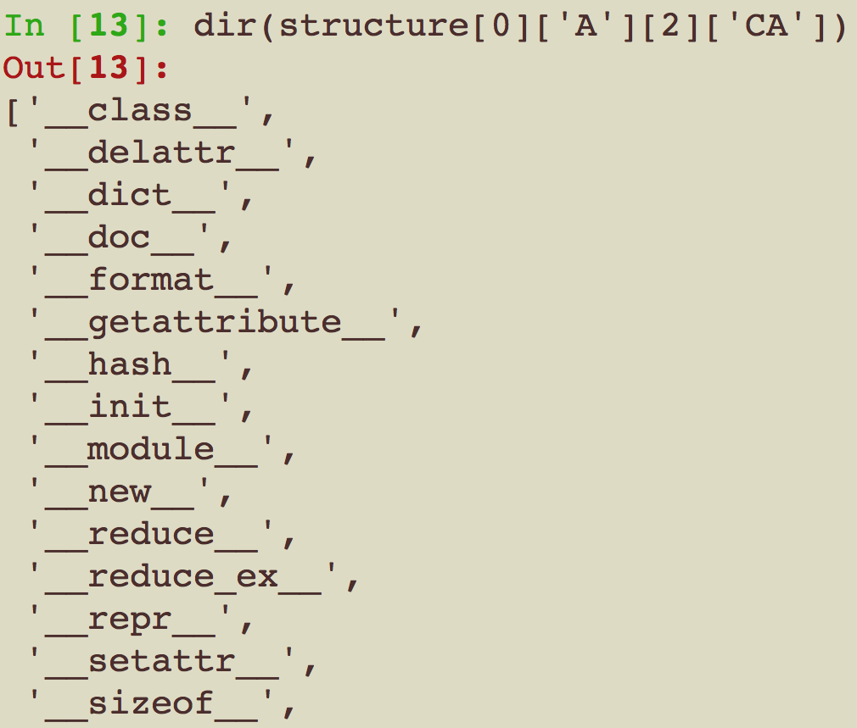

Slide 48
